Slide 1
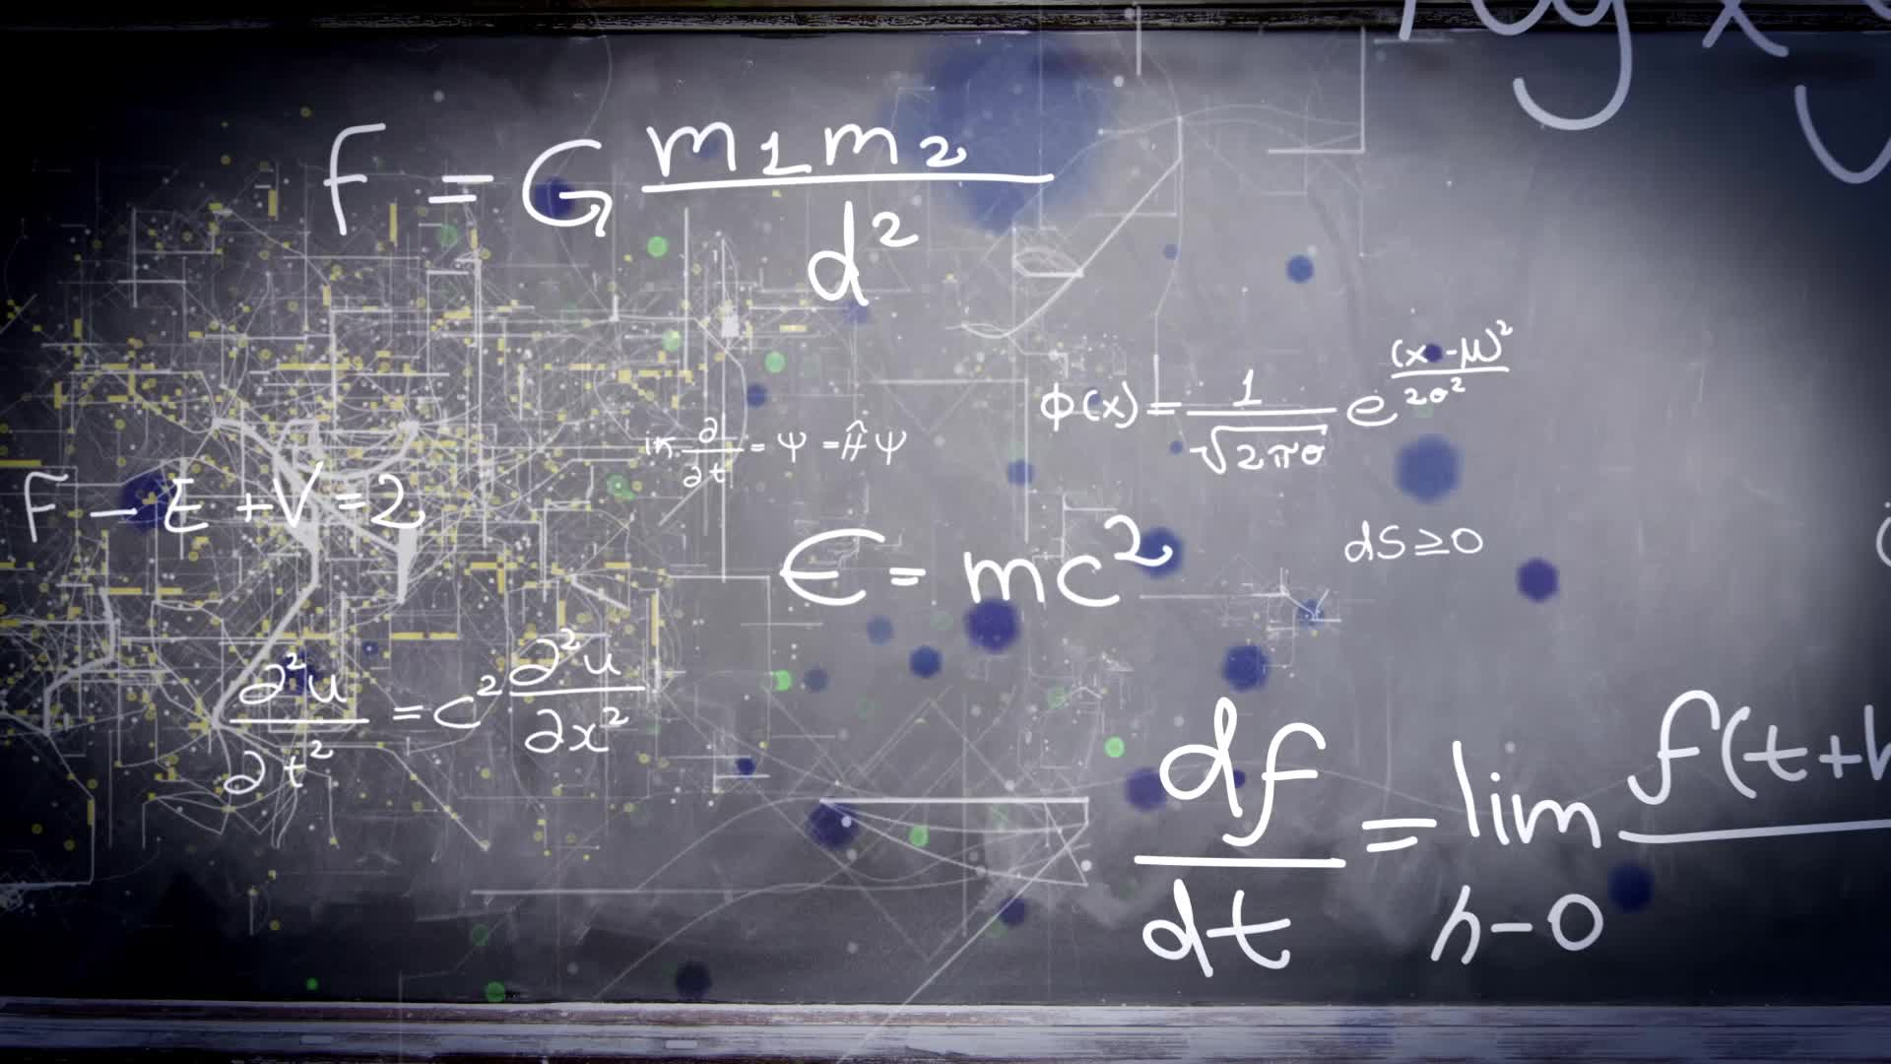
Chapters 1.1 & 1.2:
An Introduction to Limits
HONORS CALCULUS/CALCULUS

Slide 2

SECTION 1.1
A Preview of Calculus

Slide 3
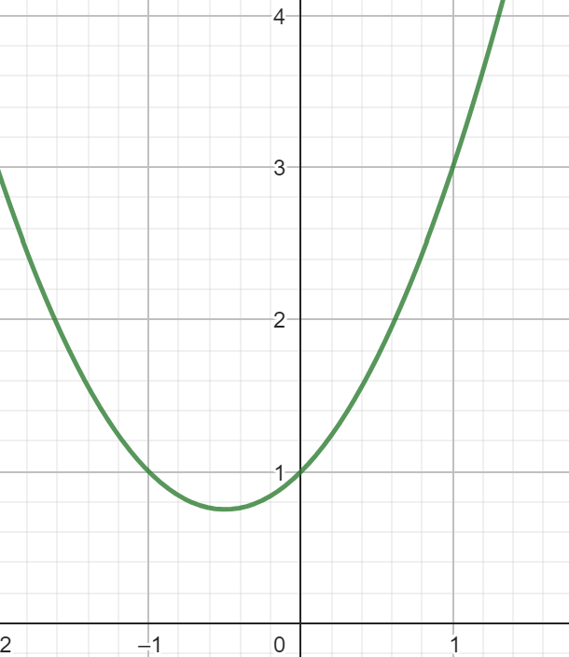
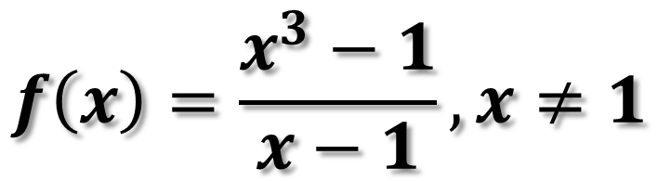

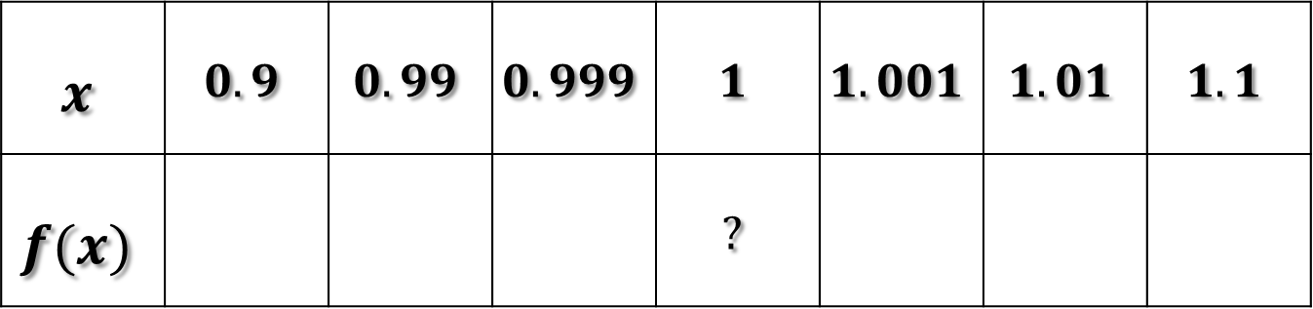
SECTION 1.2:
Describe the Behavior of $f\left(x\right)$ as x gets Closer to 1
$$f\left(x\right)=\frac{x^{3}−1}{x−1},x≠1$$
$$x$$ | $$0.9$$ | $$0.99$$ | $$0.999$$ | $$1$$ | $$1.001$$ | $$1.01$$ | $$1.1$$
$$f(x)$$ |  |  |  | $$?$$

Slide 4
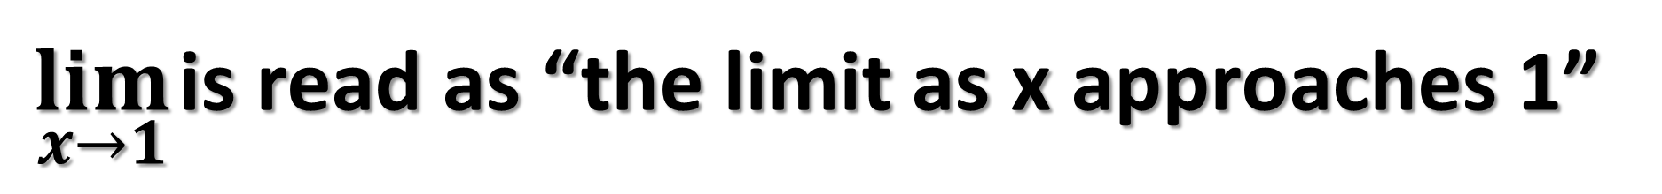
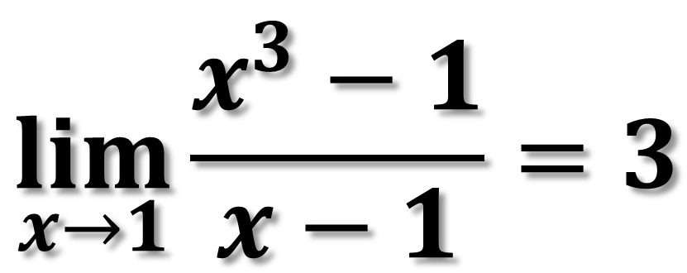
Limit: the value that a function approaches as that function's inputs get closer and closer to some number
Ex.)
$$\lim_{x→1}{\frac{x^{3}−1}{x−1}=3}$$
$\lim_{x→1}$ is read as “the limit as x approaches 1”

Slide 5
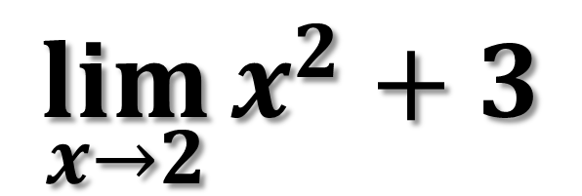
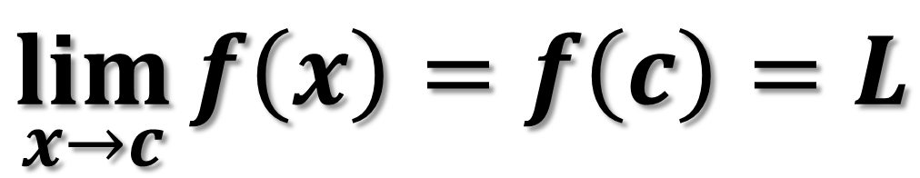
It is sometimes possible to calculate the limit of a function by plugging in the number we are approaching
$$\lim_{x→c}{f\left(x\right)=f\left(c\right)=L}$$
Ex.1)
$$\lim_{x→2}{x^{2}+3}$$

Slide 6
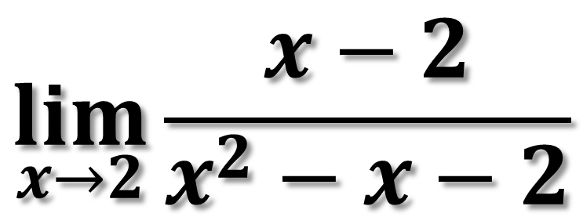
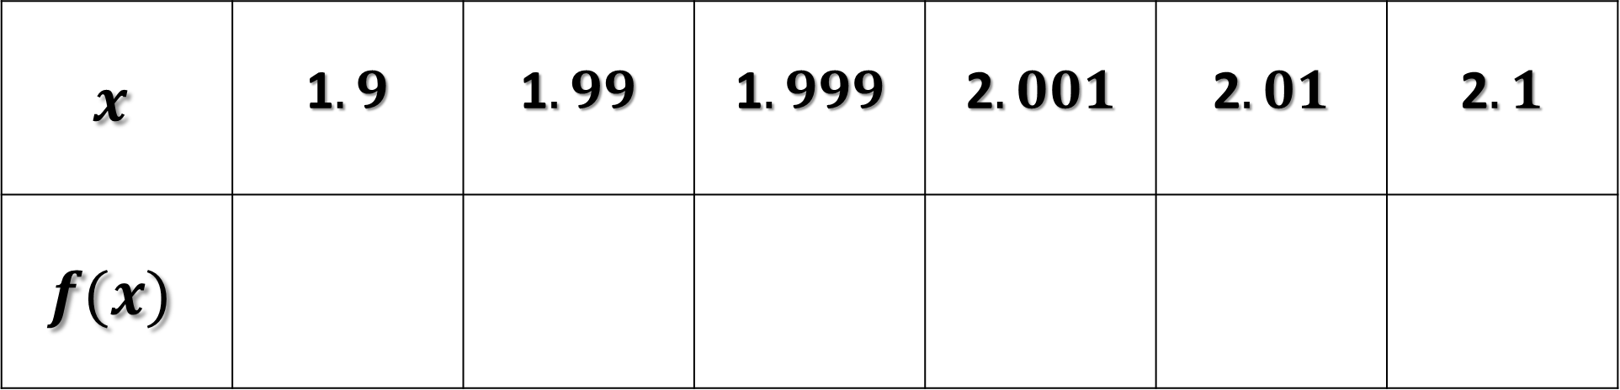
Ex.2) Estimate the limit by evaluating the function for values approaching 2
$$\lim_{x→2}{\frac{x−2}{x^{2}−x−2}}$$
$$x$$ | 1$.9$ | 1$.99$ | 1$.999$ | 2$.001$ | 2$.01$ | 2$.1$
$$f(x)$$

Slide 7
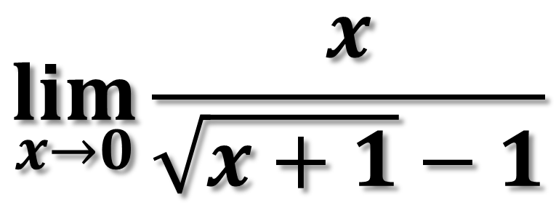
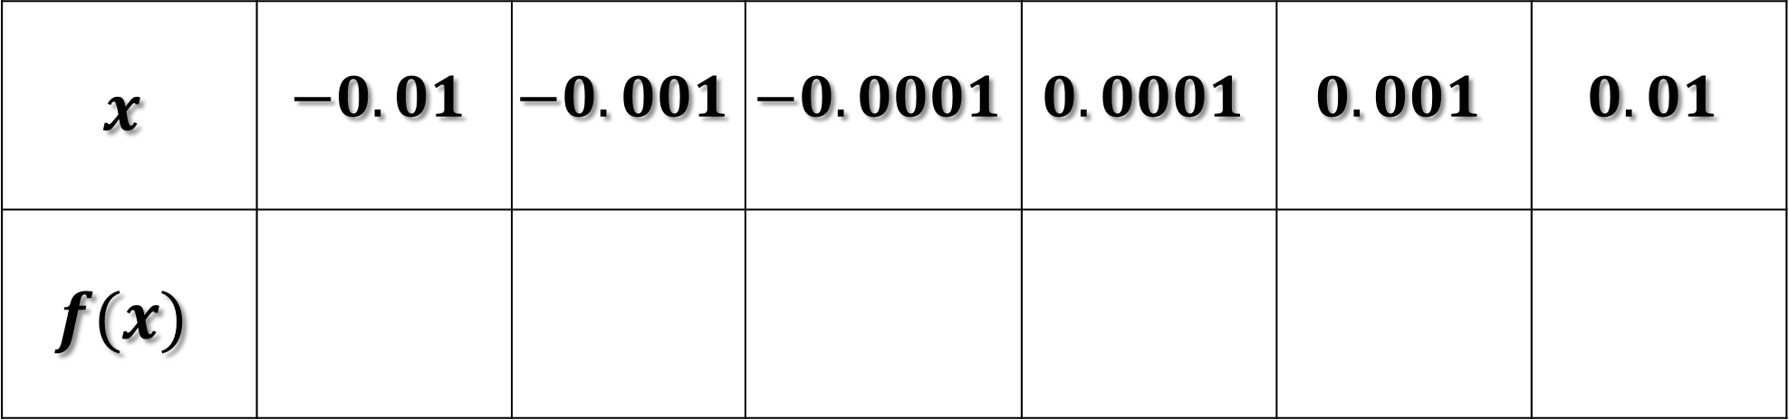
Ex.3) Estimate the limit by evaluating the function for values approaching 0
$$\lim_{x→0}{\frac{x}{\sqrt{x+1}−1}}$$
$$x$$ | $$−0.01$$ | $$−0.001$$ | $$−0.0001$$ | $$0.0001$$ | $$0.001$$ | $$0.01$$
$$f(x)$$

Slide 8
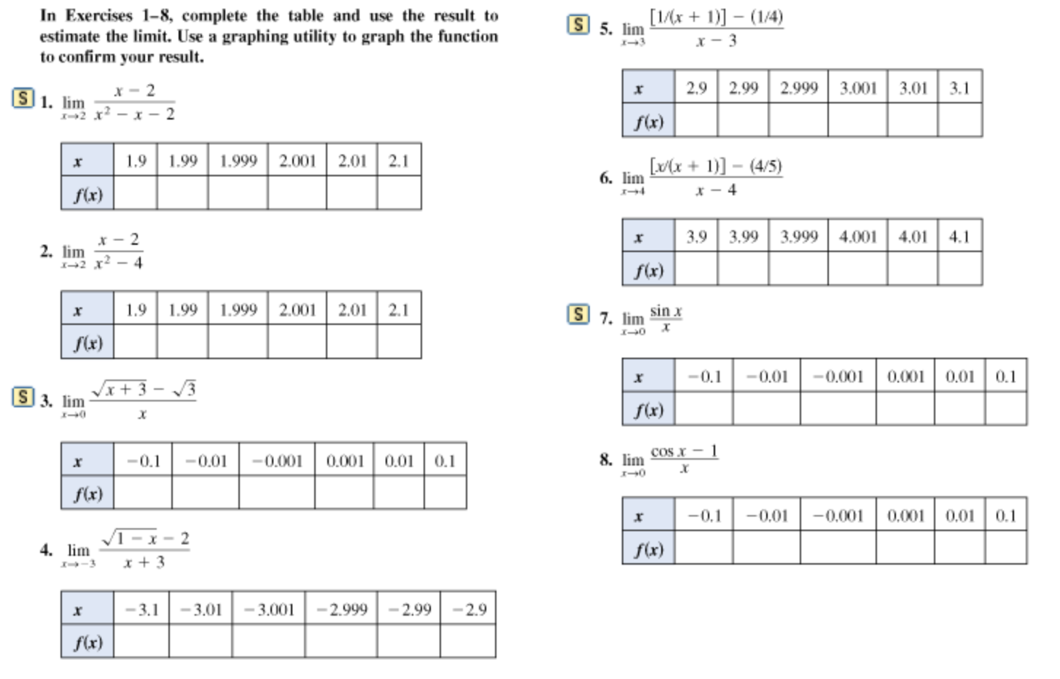

Slide 9
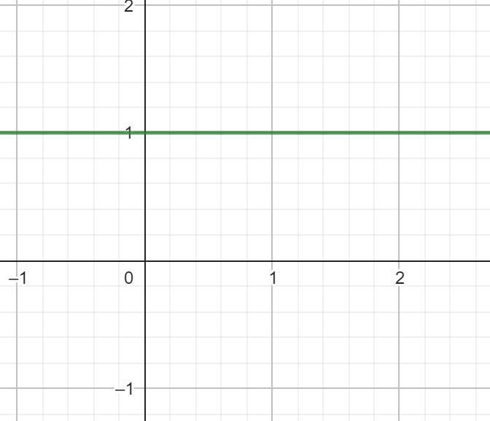
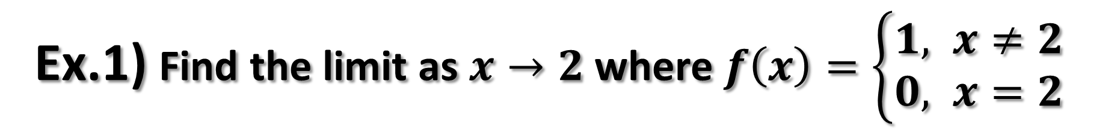

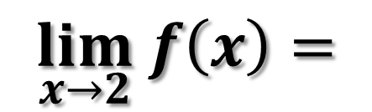

Ex.1) Find the limit as $x→2$ where $f\left(x\right)=\left\{\begin{aligned}1, x≠2 \\ &0, x=2\end{aligned}\right.$
What is the $y−value$ as $x$ approaches 2 from the left and from the right?
$$f\left(2\right)=$$
$$\lim_{x→2} f\left(x\right)=$$

Slide 10

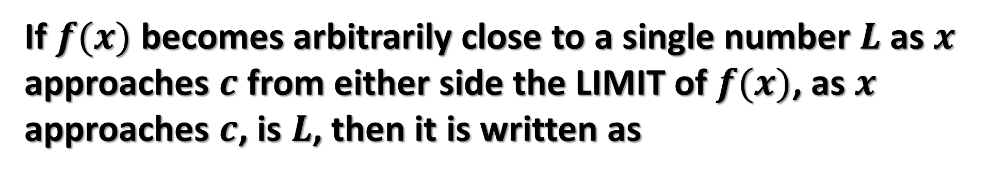
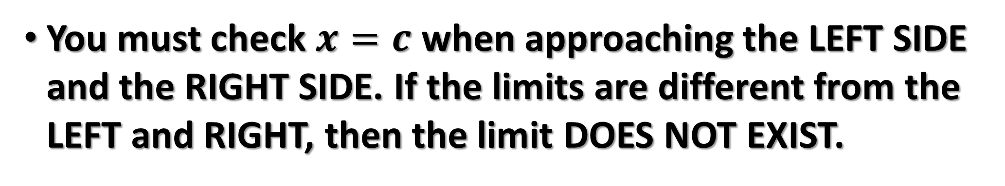
INFORMAL DEFINITION OF A LIMIT
If $f(x)$ becomes arbitrarily close to a single number $L$ as $x$ approaches $c$ from either side the LIMIT of $f(x)$, as $x$ approaches $c$, is $L$, then it is written as
$$\lim_{x→c}{f\left(x\right)=L}$$
You must check $x=c$ when approaching the LEFT SIDE and the RIGHT SIDE. If the limits are different from the LEFT and RIGHT, then the limit DOES NOT EXIST.

Slide 11
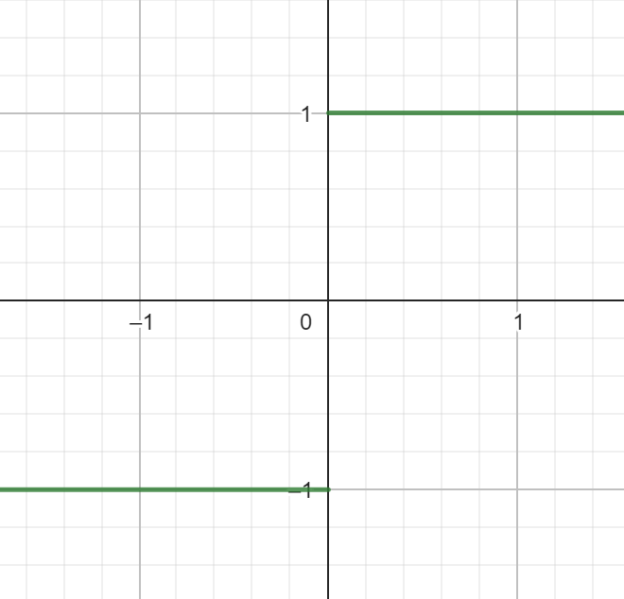
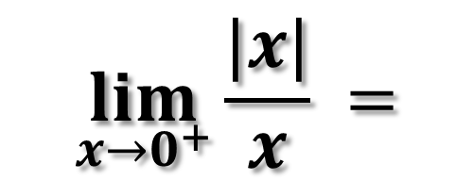
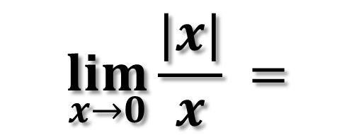
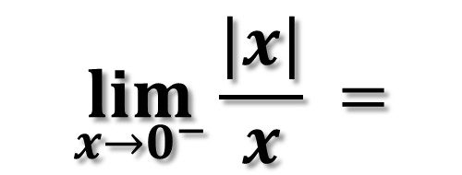
3 Ways Limits Can Fail To Exist
1.) Behavior that differs from the left and from the right.
Ex.)
$$\lim_{x→0}\frac{|x|}{x} =$$
$$\lim_{x→0^{+}}\frac{|x|}{x} =$$
$$\lim_{x→0^{−}}\frac{|x|}{x} =$$

Slide 12
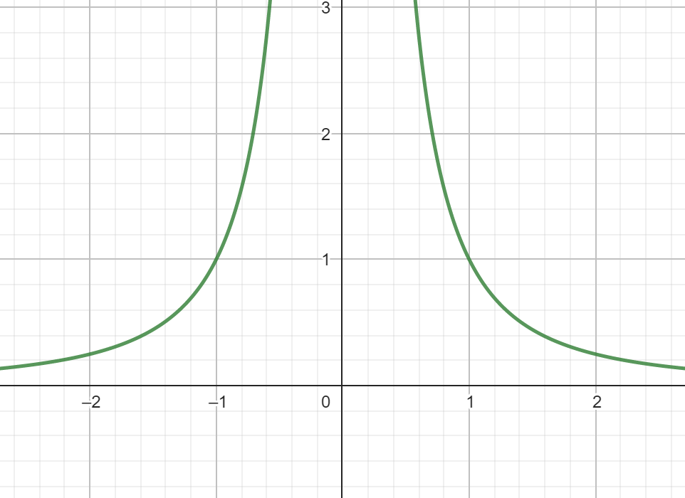
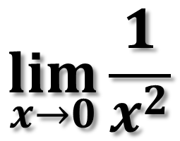
3 Ways Limits Can Fail To Exist
2.) Unbounded Behavior
$$\lim_{x→0}{\frac{1}{x^{2}}}$$

Slide 13
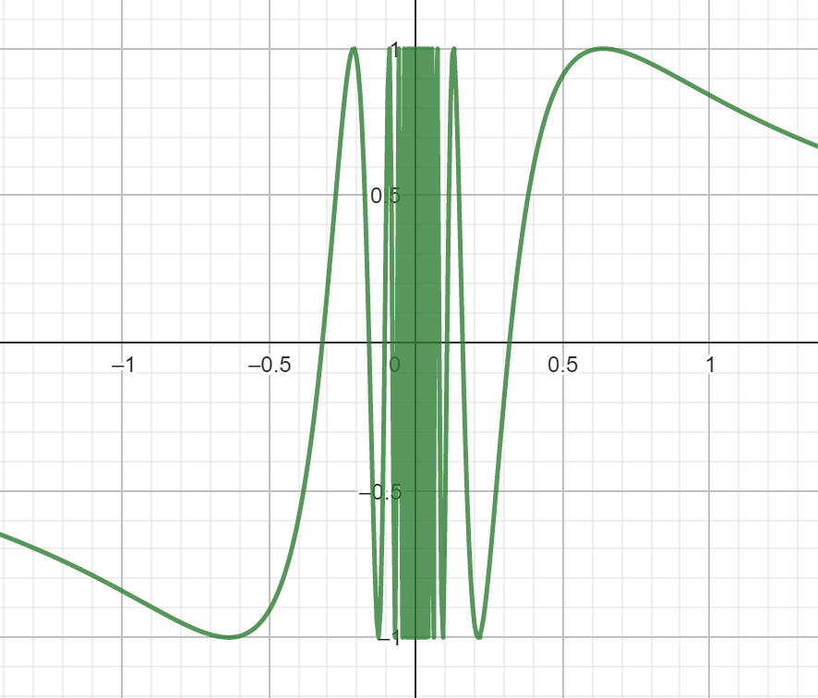
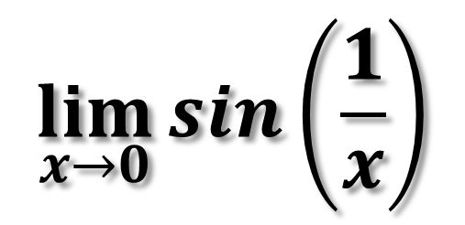
3 Ways Limits Can Fail To Exist
3.) Oscillating Behavior
$$\lim_{x→0}{sin\left(\frac{1}{x}\right)}$$

Slide 14
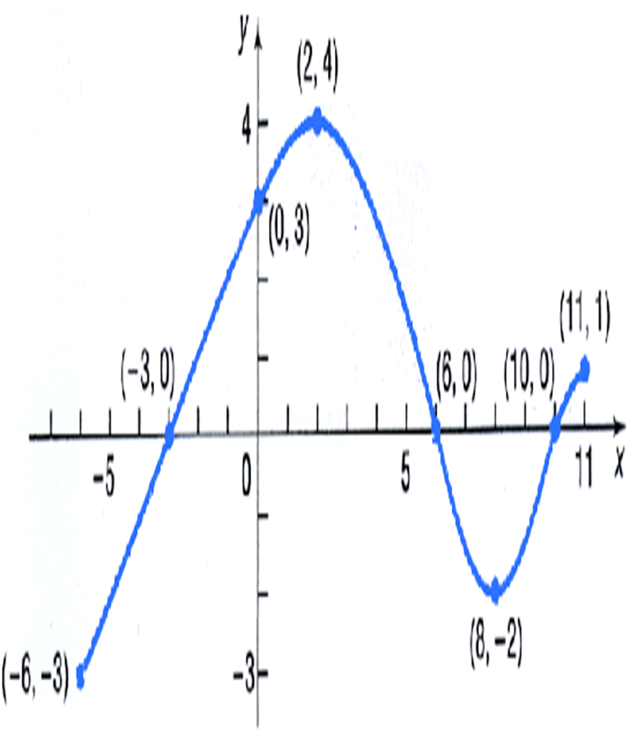
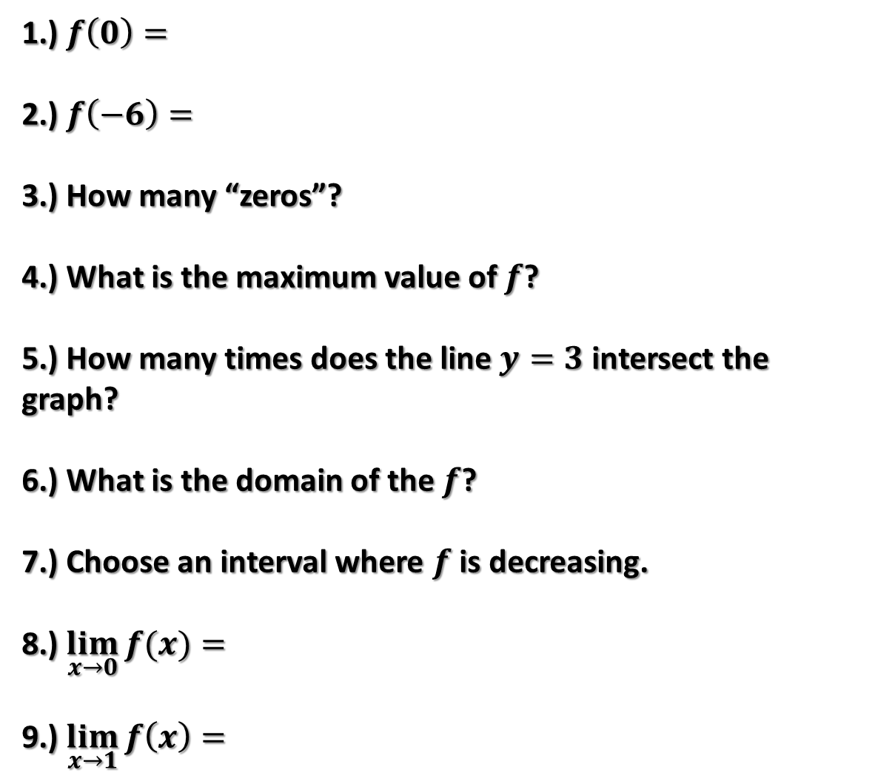
1.) $f\left(0\right)=$
2.) $f\left(−6\right)=$
3.) How many “zeros”?
4.) What is the maximum value of $f$?
5.) How many times does the line $y=3$ intersect the graph?
6.) What is the domain of the $f$?
7.) Choose an interval where $f$ is decreasing.
8.) $\lim_{x→0}{f(x)}=$
9.) $\lim_{x→1}{f\left(x\right)=}$

Slide 15
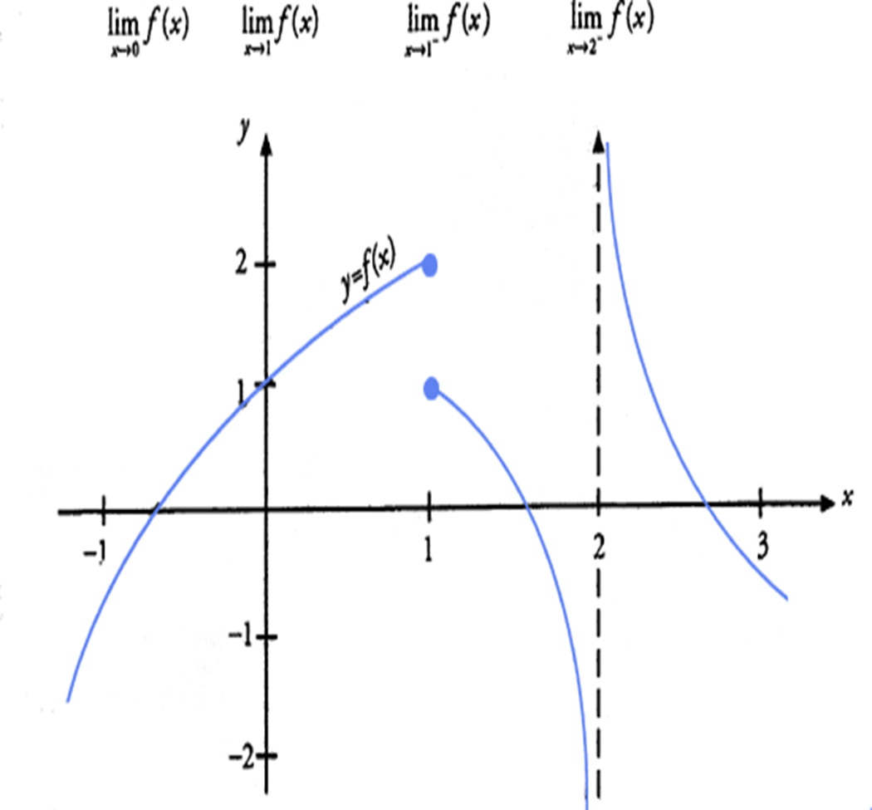
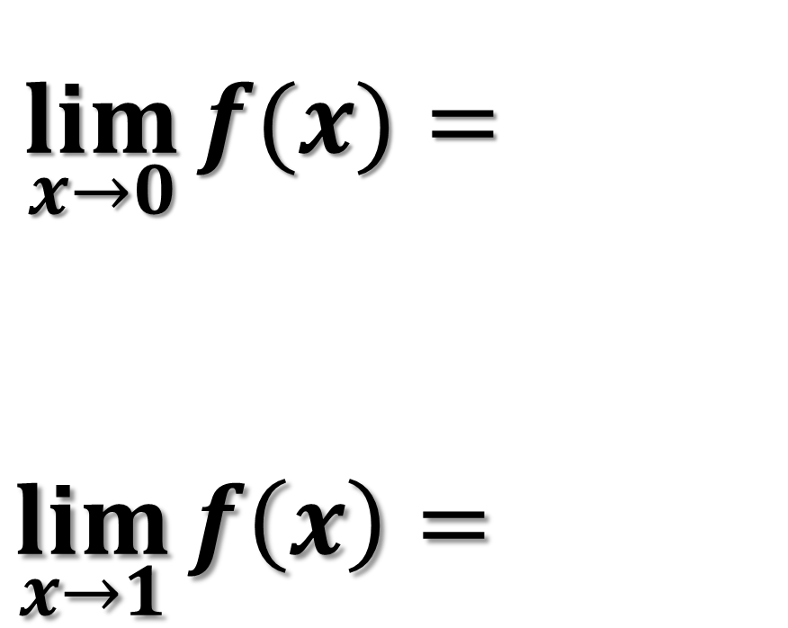
$\lim_{x→0}{f(x)}=$
$$\lim_{x→1}{f\left(x\right)=}$$

Slide 16
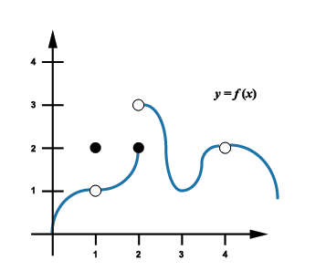
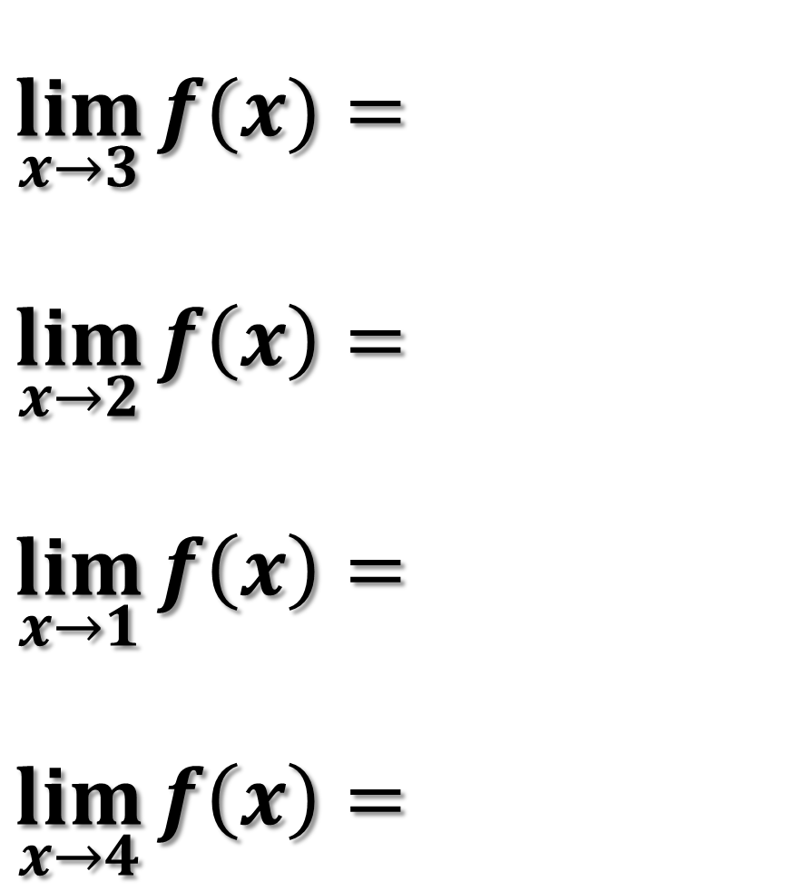
$$\lim_{x→3}{f(x)}=$$
$$\lim_{x→2}{f\left(x\right)=}$$
$$\lim_{x→1}{f\left(x\right)=}$$
$$\lim_{x→4}{f\left(x\right)=}$$

Slide 17
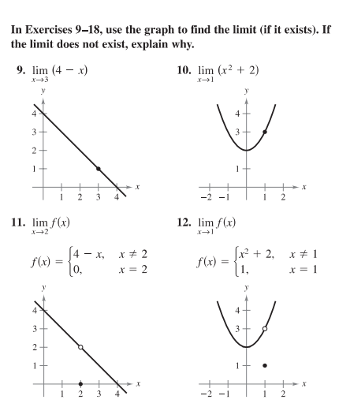

Slide 18
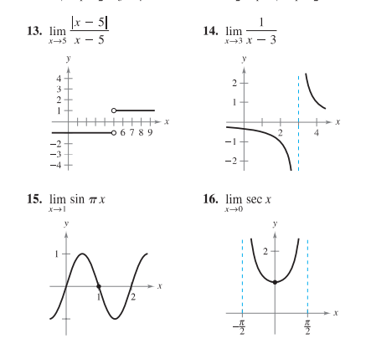

Slide 19
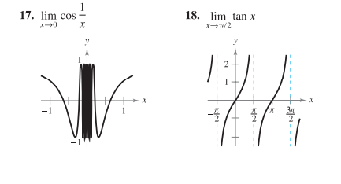

Slide 20
